Slide 1
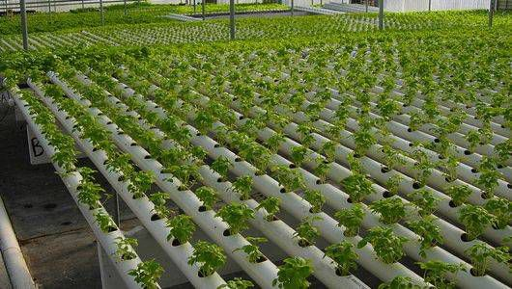
Progress Review
W.A.V.U.Wickramasinghe
160691X

Slide 2
Objective
To create a system to assist indoor plantation by enabling users to remotely monitor and work on controlling the environmental factors real-time.
Create a hardware component which can be easily installed at the site
Create system to measure environmental factors
Soil moisture
Temperature
Humidity
Ambient Light condition
Create a method to monitor measured values through internet

Slide 3
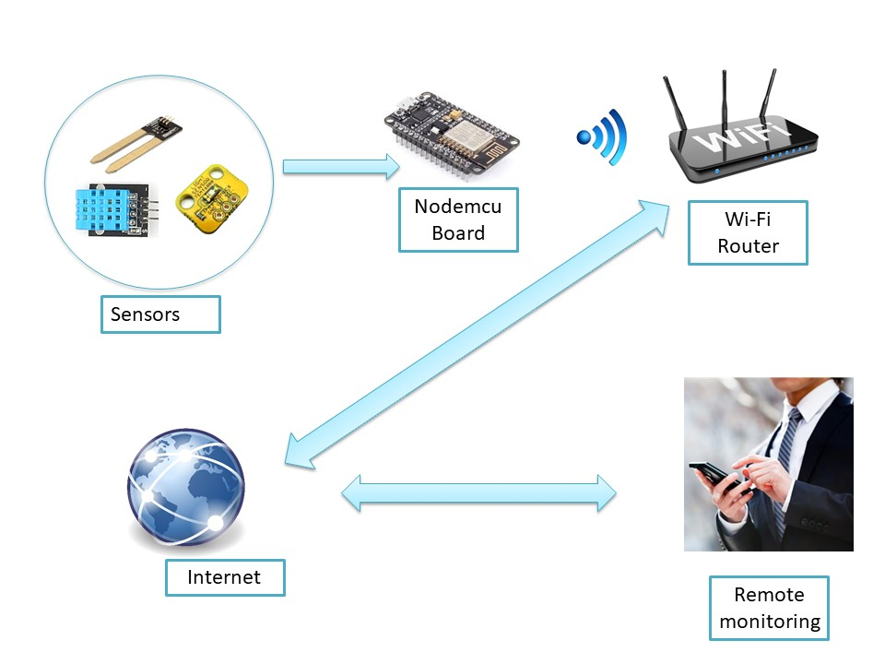
Conceptual design 1

Slide 4
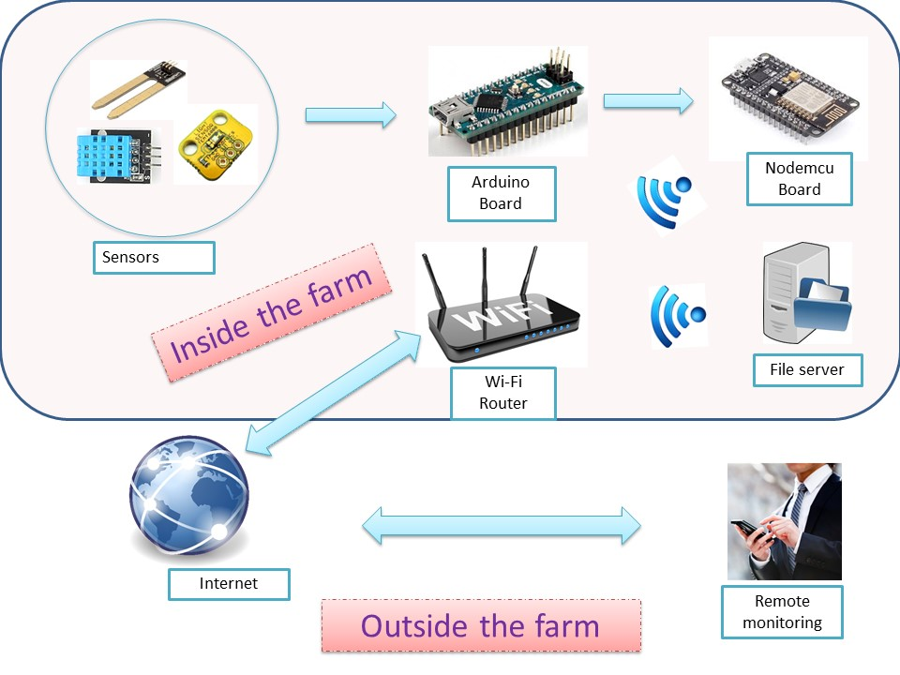
Conceptual design 2

Slide 5
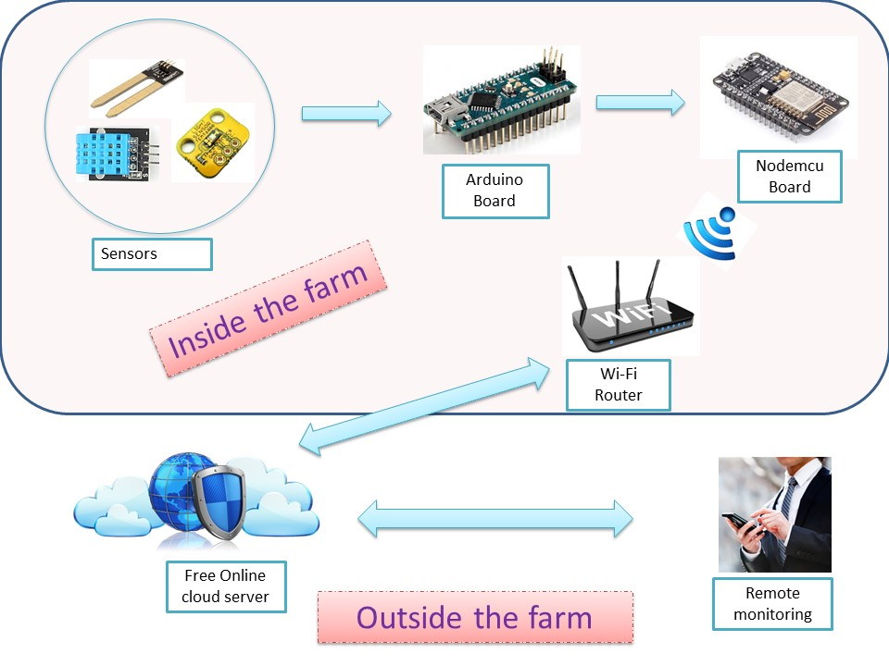
Conceptual design 3

Slide 6

Final Solution
Design 3 is selected as the final solution
The sensors , Arduino board ,
nodemcu board and wifi router is
placed inside the farm
All components are powered using domestic supply
Router must have an active internet connection

Slide 7
Significance of the Solution
Overhead of performing calculations is taken by the Arduino board
Nodemcu Board’s only task is to transmit data to online server as a client using Wi-Fi.
Cost for the components has reduced since there is no computer is dedicated for the system in this solution
Reliability of the connection is increased since latest data about the farm is always available in an online server

Slide 8
Component List
Arduino nano board
Nodemcu Board
Humidity Sensor
Soil moisture sensor
Temperature Sensor
Ambient Light Sensor
Power module 230V AC ---→ 12V DC
Wi-Fi connection
Connecting wires
0.1uF capacitors for noise reduction in power supply

Slide 9
Calculations
Average Current requirement for sensors - 2mA
Maximum Current requirement for Arduino and
NodeMCU board - 200mA
Rating of power supply - 12V DC 500mA
7805 Voltage regulator or 12V DC → 5V DC buck converter will be used to power microcontrollers

Slide 10
THANK YOU !

